Slide 1
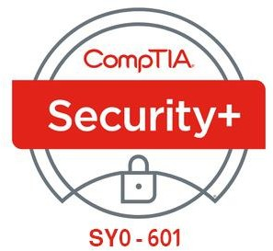

11- Implementing Secure Network Protocols
Ehab Fahmi
Senior Cyber Security Consultant - Instructor

Slide 2
Outlines
11.1- Implement Secure Network Operations
11.2- Implement Secure Application Protocols
11.3- Implement Secure Remote Access Protocols

Slide 3
NETWORK ADDRESS ALLOCATION
Most networks use a mixture of static and dynamic address allocation.
Interface addresses for routers, firewalls, and some types of servers are best assigned and managed manually.
Other server services and client workstations can be assigned dynamic IP configurations and accessed using name resolution.
The Dynamic Host Configuration Protocol (DHCP) provides an automatic method for network address allocation.
The key point about DHCP is that only one server should be offering addresses to any one group of hosts.

Slide 4
NETWORK ADDRESS ALLOCATION (cont.)
If a rogue DHCP server is set up, it can perform DoS (as client machines will obtain an incorrect TCP/IP configuration) or be used to snoop network information.
DHCP starvation is a type of DoS attack where a rogue client repeatedly requests new IP addresses using spoofed MAC addresses, with the aim of exhausting the IP address pool.
This makes it more likely that clients seeking an address lease will use the rogue
DHCP server.

Slide 5
NETWORK ADDRESS ALLOCATION (cont.)
Enabling the DHCP snooping port security feature on a switch can mitigate rogue DHCP attacks.
Windows DHCP servers in an AD environment automatically log any traffic detected from unauthorized DHCP servers.
More generally, administration of the DHCP server itself must be carefully controlled and the settings checked regularly.
If an attacker compromises the DHCP server, he or she could point network clients to rogue DNS servers and use that as a means to direct users to spoofed websites.
Another attack is to redirect traffic through the attacker's machine by changing the default gateway, enabling the attacker to snoop on all network traffic.

Slide 6
DOMAIN NAME RESOLUTION
The Domain Name System (DNS) resolves fully qualified domain names (FQDNs) to IP addresses.
It uses a distributed database system that contains information on domains and hosts within those domains.
The information is distributed among many name servers, each of which holds part of the database.
The name servers work over port 53.
Domain name resolution is a security-critical service and the target of many attacks on both local network and the Internet.

Slide 7
DOMAIN NAME RESOLUTION (cont.)
DNS POISONING
DNS poisoning is an attack that compromises the process by which clients query name servers to locate the IP address for a FQDN.
There are several ways that a DNS poisoning attack can be perpetrated.
Man in the Middle
If the threat actor has access to the same local network as the victim, the attacker can use ARP poisoning to impersonate a legitimate DNS server and respond to DNS queries from the victim with spoofed replies.
This might be combined with a denial of service attack on the victim's legitimate DNS server.
A rogue DHCP could be used to configure clients with the address of a rogue DNS resolver.

Slide 8
DOMAIN NAME RESOLUTION (cont.)
DNS Client Cache Poisoning
Before DNS was developed in the 1980s, name resolution took place using a text file named HOSTS.
Each name:IP address mapping was recorded in this file and system administrators had to download the latest copy and install it on each Internet client or server manually.
Even though all name resolution now functions through DNS, the HOSTS file is still present and most operating systems check the file before using DNS.
Its contents are loaded into a cache of known name:IP mappings and the client only contacts a DNS server if the name is not cached.
Therefore, if an attacker is able to place a false name:IP address mapping in the HOSTS file and effectively poison the DNS cache, he or she will be able to redirect traffic.
The HOSTS file requires administrator access to modify.
In UNIX and Linux systems it is stored as /etc/hosts, while in Windows it is placed in
%SystemRoot%\System32\Drivers\etc\hosts.

Slide 9
DOMAIN NAME RESOLUTION (cont.)
DNS Server Cache Poisoning
DNS server cache poisoning aims to corrupt the records held by the DNS server itself.
This can be accomplished by performing DoS against the server that holds the authorized
records for the domain, and then spoofing replies to requests from other name servers.

Slide 10
DNS SECURITY
DNS Security Extensions (DNSSEC)
Help to mitigate against spoofing and poisoning attacks by providing a validation process for DNS responses.
With DNSSEC enabled, the authoritative server for the zone creates a "package" of resource records signed with a private key (the Zone Signing Key).
When another server requests a secure record exchange, the authoritative server returns the package along with its public key, which can be used to verify the signature.
The public zone signing key is itself signed with a separate Key Signing Key.
Separate keys are used so that if there is some sort of compromise of the zone signing key, the domain can continue to operate securely by revoking the compromised key and issuing a new one.

Slide 11
TRANSPORT LAYER SECURITY
As with other early TCP/IP application protocols, HTTP communications are not secured.
Secure Sockets Layer (SSL) was developed by Netscape in the 1990s to address the lack of security in HTTP.
SSL proved very popular with the industry, and it was quickly adopted as a standard named Transport Layer Security (TLS).
It is typically used with HTTP (referred to as HTTPS or HTTP Secure) but can also be used to secure other application protocols and as a virtual private networking (VPN) solution.

Slide 12
FILE TRANSFER SERVICES
A File Transfer Protocol (FTP) server is typically configured with several public directories, hosting files, and user accounts.
Most HTTP servers also function as FTP servers, and FTP services, accounts, and directories may be installed and enabled by default when you install a web server.
FTP is more efficient compared to file attachments or HTTP file transfer, but has no security mechanisms.
All authentication and data transfer are communicated as plaintext, meaning that
credentials can easily be picked out of any intercepted FTP traffic.

Slide 13
REMOTE ACCESS ARCHITECTURE
Remote access means that the user's device does not make a direct cabled or wireless connection to the network.
The connection occurs over or through an intermediate network.
Historically, remote access might have used analog modems connecting over the telephone system or possibly a private link (a leased line).
These days, most remote access is implemented as a virtual private network (VPN), running over the Internet.
Administering remote access involves essentially the same tasks as administering the local network.

Slide 14
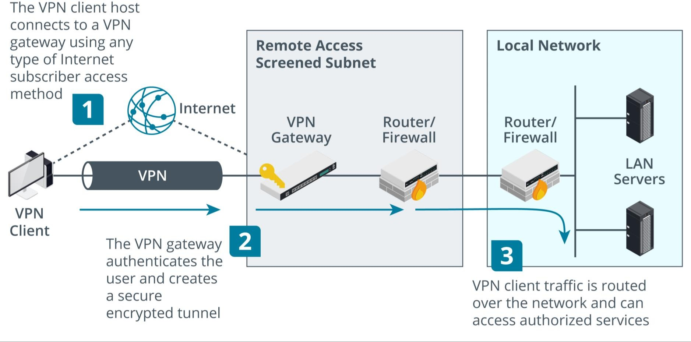
REMOTE ACCESS ARCHITECTURE (cont.)

Slide 15
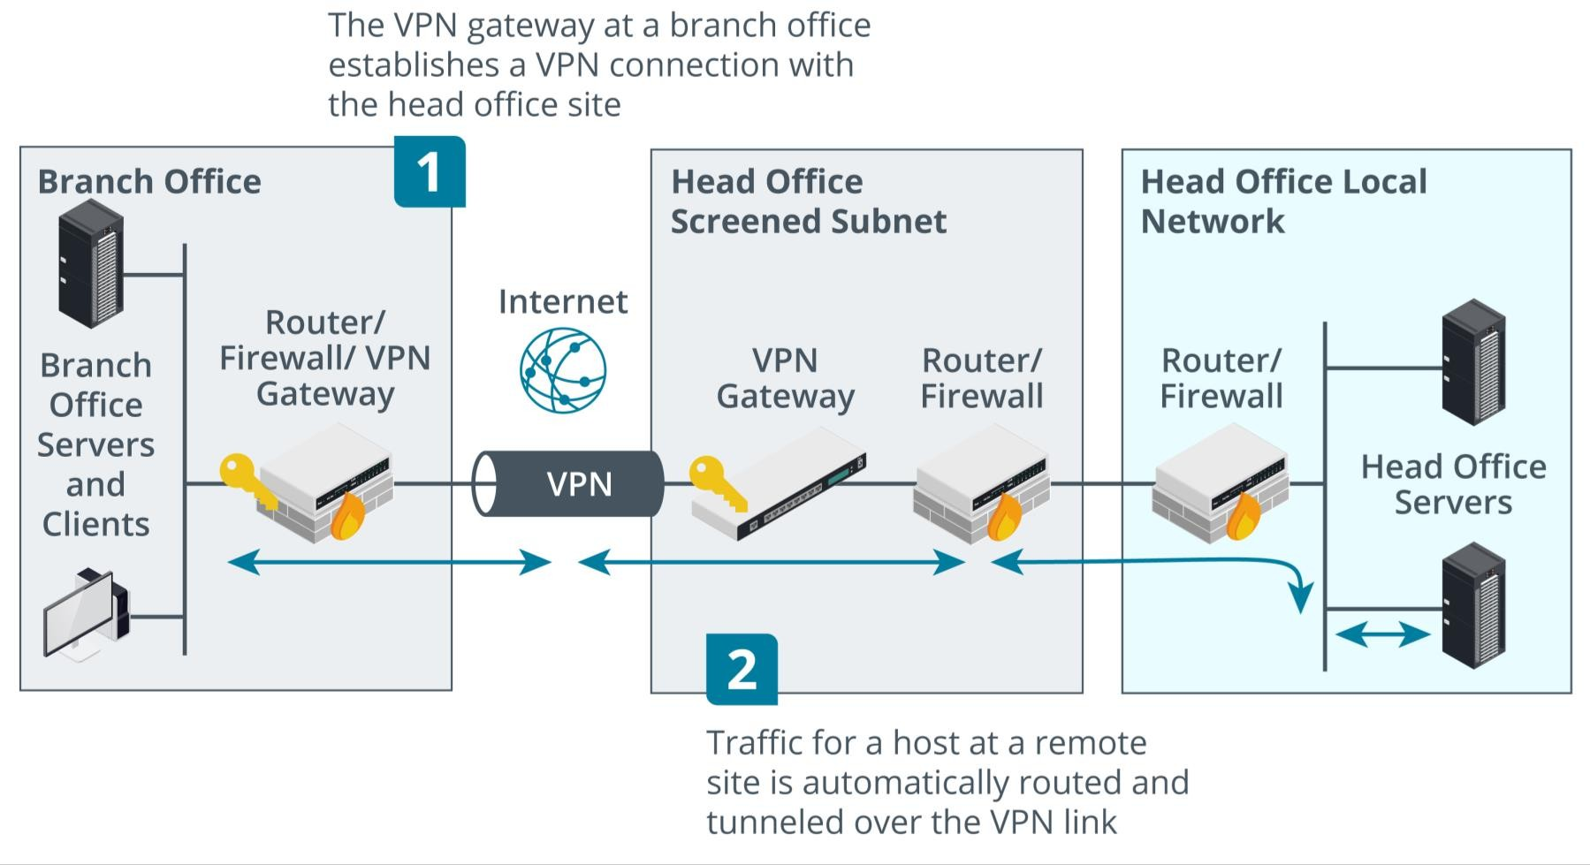
REMOTE ACCESS ARCHITECTURE (cont.)

Slide 16
REMOTE DESKTOP
Another model for remote networking involves connecting to a host within the local network over a remote administration protocol.
A protocol such as Secure Shell (SSH) traditionally provides terminal access, and there are many tools that can connect to a graphical desktop.
A GUI remote administration tool sends screen and audio data from the remote host to the client and transfers mouse and keyboard input from the client to the remote host.
Microsoft's Remote Desktop Protocol (RDP) can be used to access a physical machine on a one-to-one basis.

